Slide 1

DATE: 19TH JUL 2024
DEMAND FORECASTING FOR E-COMMERCE
PRESENTED BY – Madina Shanmukha Rao
shannu0306@gmail.com

Slide 2
CONTENTS:
Problem Statement
Data Introduction
Data Overview
Feature Engineering
Linear Regression Impact
Visualization
Time Series Analysis
Demand Forecasting Model
Comparison of All Forecasting Models
Conclusion

Slide 3
PROBLEM STATEMENT:
In the competitive e-commerce landscape, precise demand forecasting is crucial for success. This project aims to develop an advanced demand forecasting model utilizing historical sales data and key Google Analytics metrics, including Google clicks and Facebook impressions, to predict future product demand and gain insights into customer interest and behavior.
Create an Accurate Demand Forecasting Model:
-> Leverage historical sales data and Google Analytics KPIs to accurately predict future demand.
-> Optimize inventory management and refine sales strategies.
Discover and Analyze Sales Trends and Seasonal Patterns:
-> Detect significant trends and seasonal patterns in sales data.
-> Anticipate the impact of recurring events on demand.
Assess the Impact of Online Advertising and Social Media Marketing:
-> Assess the influence of Google clicks and Facebook impressions on sales.
-> Examine the effects of online advertising and social media campaigns on consumer purchasing behavior.
Develop Reliable Predictive Models:
-> Investigate correlations between sales, clicks, and impressions.
-> Create predictive models to improve the accuracy of demand forecasts.

Slide 4
DATA INTRODUCTION:
We have three datasets:
1. ProductA_google_clicks.xlsx: Contains columns for Date Index and Google Clicks.
2. ProductA_fb_impressions.xlsx: Contains columns for Date Index and Facebook Impressions.
3. ProductA.xlsx: Contains columns for Date Index and Quantity Sales.
These datasets were merged using a left join to form merged_df.xlsx, which includes 212 rows and 4 columns: Day Index, Quantity, Clicks, and Impressions.
-> Dependent Variable: Quantity
-> Independent Variables: Clicks, Impressions

Slide 5
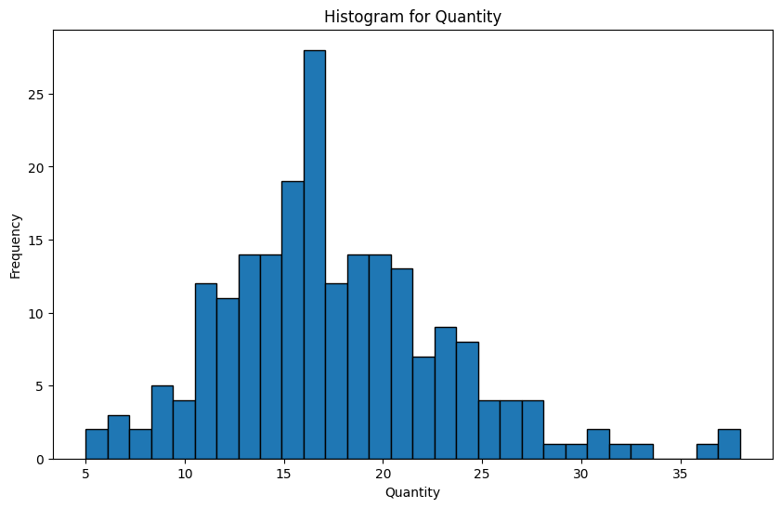
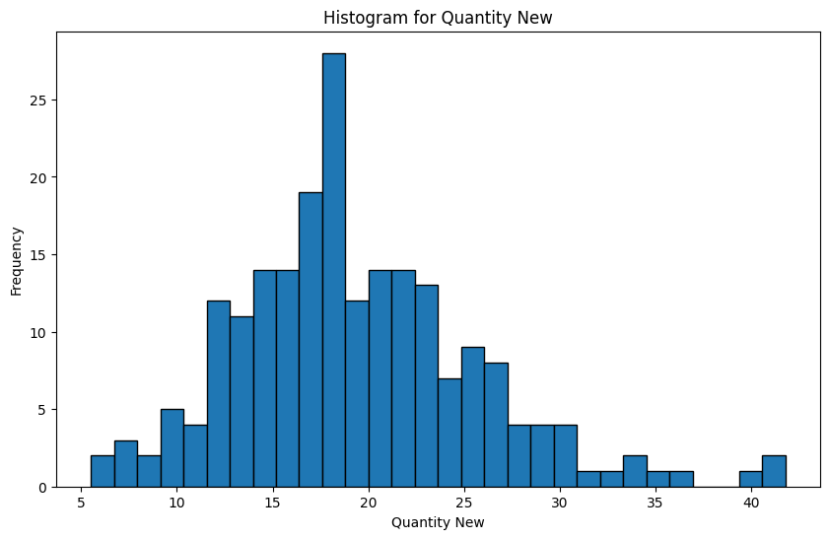
DATA OVERVIEW:
Inspecting for Missing Values and Removing Duplicates:
-> There are no missing values in the 'Quantity', 'Clicks', and 'Impressions' columns.
-> No duplicate rows were found, so no rows were removed.
Analysis of Outliers:
The histogram illustrates the distribution of data with different frequencies, showing a noticeable peak in the quantity range of 15 to 20. This indicates that most values fall within this range, suggesting a common occurrence of quantities around 15 to 20.

Slide 6
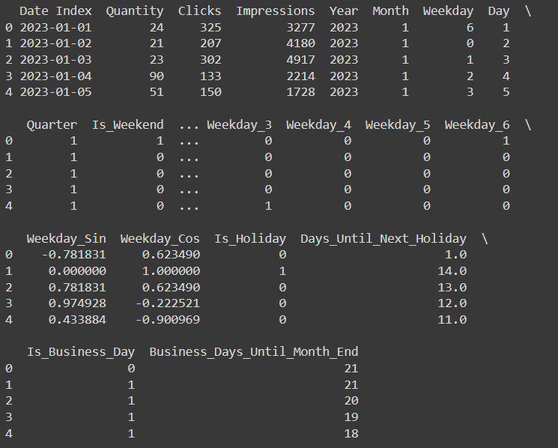
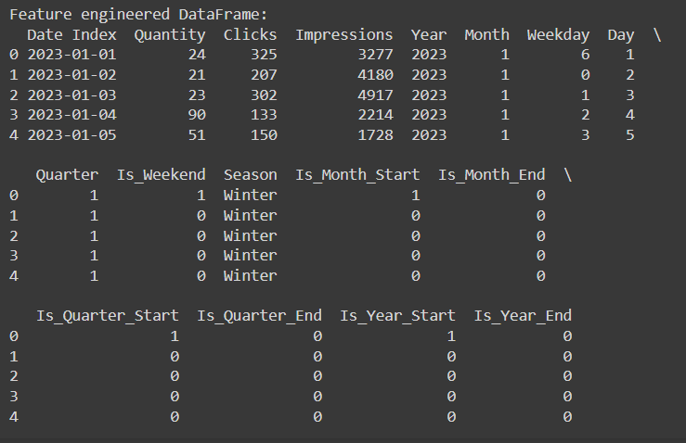
FEATURE ENGINEERING:
-> Several new features were created to enrich the dataset, aiming to boost predictive accuracy by including contextual factors that affect the target variable.
-> Following feature engineering, the variables include: 1.Date index, 2.Quantity, 3.Clicks, 4.Impressions, 5.Year, 6.Month, 7.Weekend, 8.Day, 9.Quarter, 10.Is_weekend, 11.Weekend_3, 12.Weekend_4, 13.Weekend_5, 14.Weekend_6, 15.Weekend_sin, 16.Weekend_cos, 17.Is_Holiday, 18.Days_Until_Next_Holiday, 19.Is_Business_Day, 20. Business_Days_Until_Month_End, 21.Season, 22. Is_Month_Start, 23.Is_Month_End, 24.Is_Quarter_Start, 25.Is_Quarter_end, 26.Is_Year_Start, 27.Is_Year_End

Slide 7
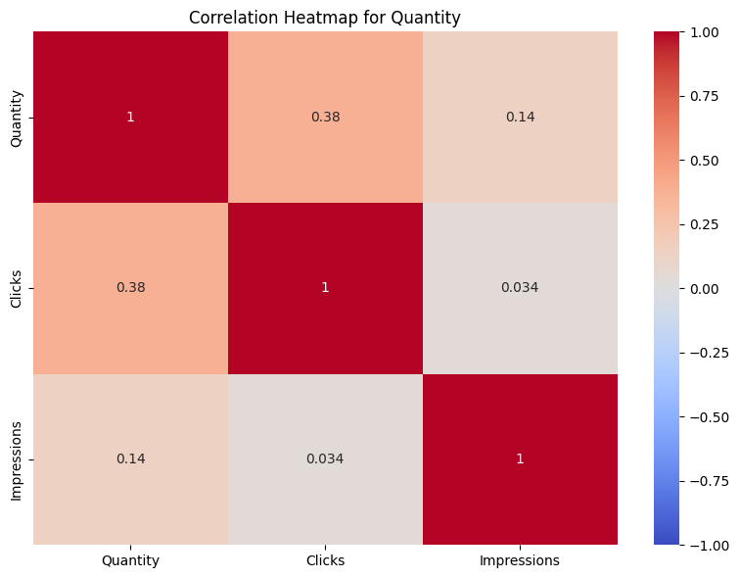
CORRELATION MATRIX:
Quantity and Clicks:
Moderate Positive Correlation of 0.38, suggesting higher clicks lead to increased sales quantity.
Quantity and Impressions:
Weak positive correlation of 0.14, indicating a slight association between higher impressions and higher sales quantity.
Clicks and Impressions:
Very weak correlation of 0.034, showing clicks and impressions are nearly independent
Self-Correlation:
Each Variable has a perfect correlation with itself, shown by the dark red diagonal.

Slide 8
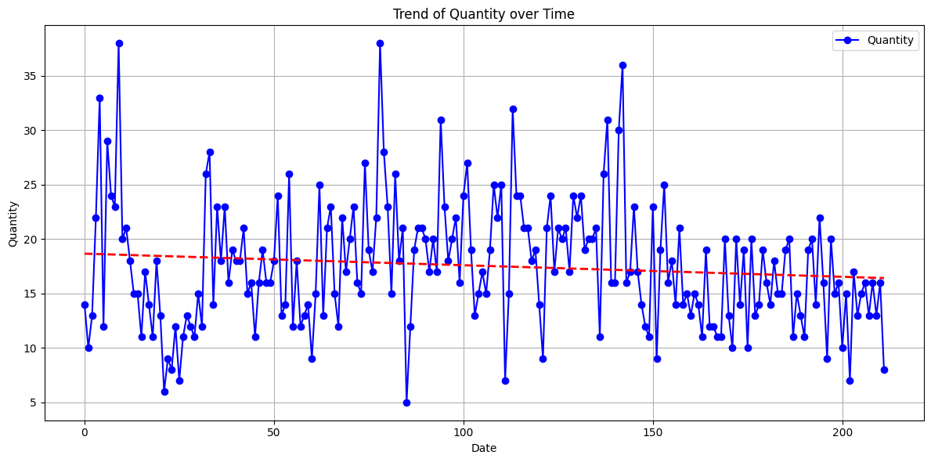
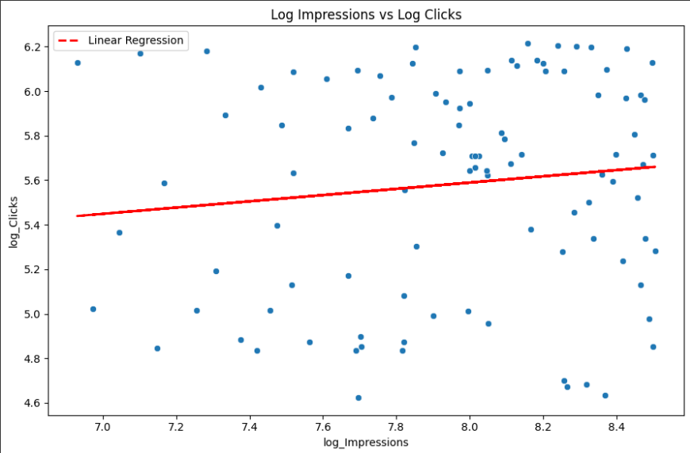
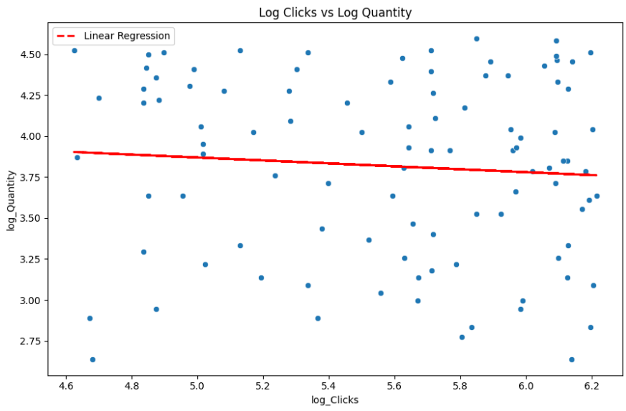
LINEAR REGRESSION:
Trend of Quantity Over Time
Log Impressions vs Log Clicks
Log Clicks vs Log Clicks
->The quantity shows a slight downward trend over time, indicated by the red trend line, with significant fluctuations, including frequent peaks and troughs.
->The quantity occasionally reaches high values (30-35) and low values (5-10), suggesting periods of unusually high and low quantities, with a comprehensive dataset covering a significant time span.
-> The red linear regression line shows a positive correlation between log impressions and log clicks, although the considerable dispersion around the line indicates that the trend is not very strong.
-> Most data points are clustered between log impressions of 7.5 to 8.5 and log clicks of 5.0 to 6.0, with a few outliers at the lower end, which could affect the correlation's strength and accuracy.
-> There is a slight negative correlation between log clicks and log quantity, with significant variability and dispersion.
-> Data points are evenly spread with no strong clustering or significant outliers.

Slide 9
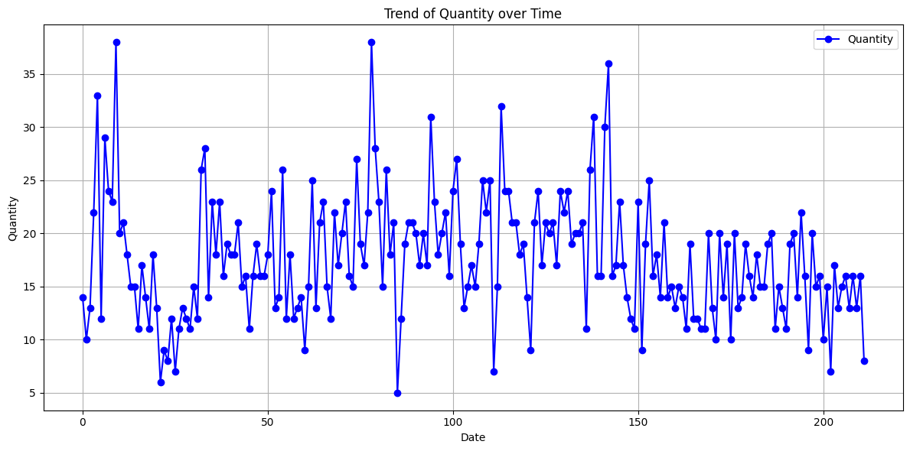
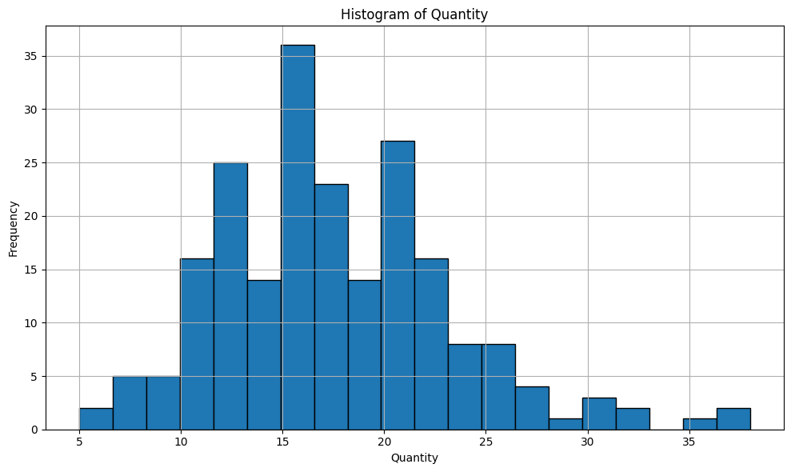
VISUALIZATION:
Trend of Quantity Over Time
Histogram of Quantity
-> The line graph shows significant peaks and troughs in quantity over time, indicating fluctuations in sales.
-> The blue line represents the quantity, highlighting the variability in the data points throughout the period.
-> The histogram shows a distribution of data with varying frequencies.
-> It peaks around the quantity range of 15 to 20.

Slide 10
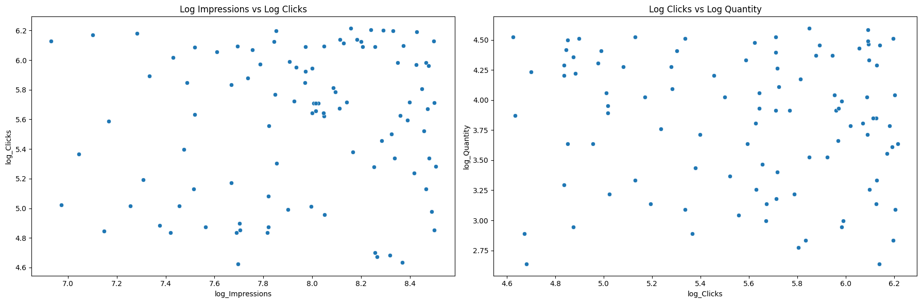
-> The scatter plots demonstrate positive correlations between variables.
-> The left plot ("Log Impressions vs Log Clicks") shows that as impressions increase, clicks also increase.
-> The right plot ("Log Clicks vs Log Quantity") indicates that higher click counts correspond to greater quantities.

Slide 11
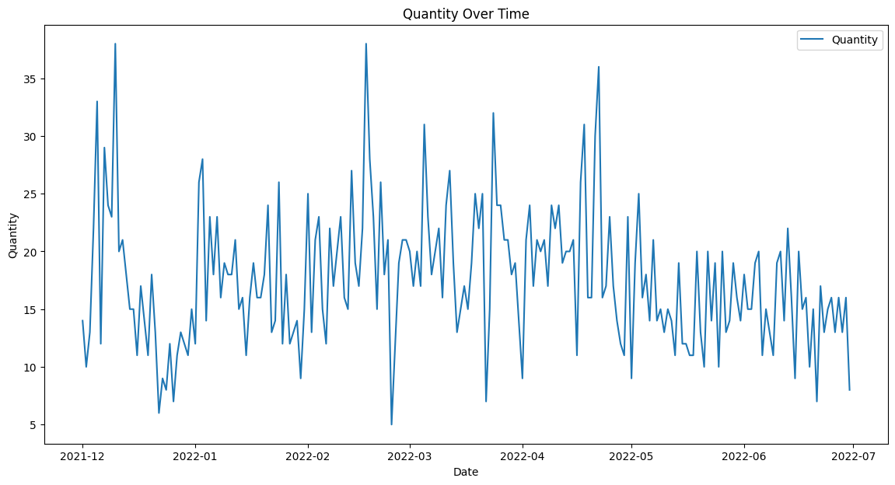
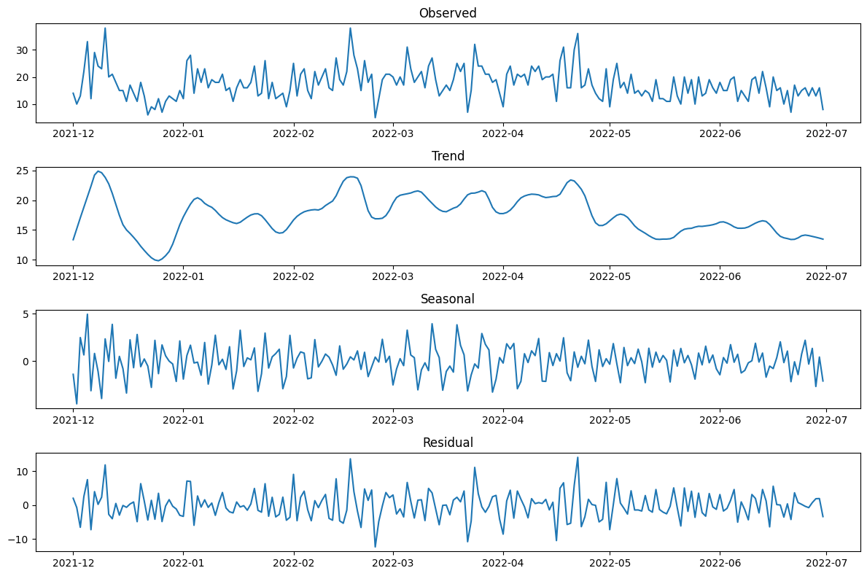
Time Series Analysis:
Trend:
Seasonlity:
Observed
-> Shows actual quantity from Dec 2021 to Jul 2022, with high volatility.
-> Frequent, irregular changes reflect significant variability.
Trend
-> Upward trend from Dec 2021 to early 2022.
-> Downward trend starting around May 2022.
Seasonal
-> Consistent cyclical patterns, possibly weekly or monthly.
-> Regular ups and downs indicate seasonality.
Residual
-> Fluctuations around zero after removing trend and seasonality.
-> Spikes indicate unexplained unusual changes.
-> The data shows significant fluctuations throughout the period, with peak quantities exceeding 35 units around December 2021 and April 2022, indicating periods of high demand or supply.
-> Higher quantities are observed in late 2021 and early to mid-2022, suggesting seasonal trends, followed by a general downward trend from May 2022 onwards.
-> Brief stability in January-February 2022 and June 2022, with notable sharp drops in early January 2022 and May 2022, potentially due to supply chain issues or reduced demand.

Slide 12
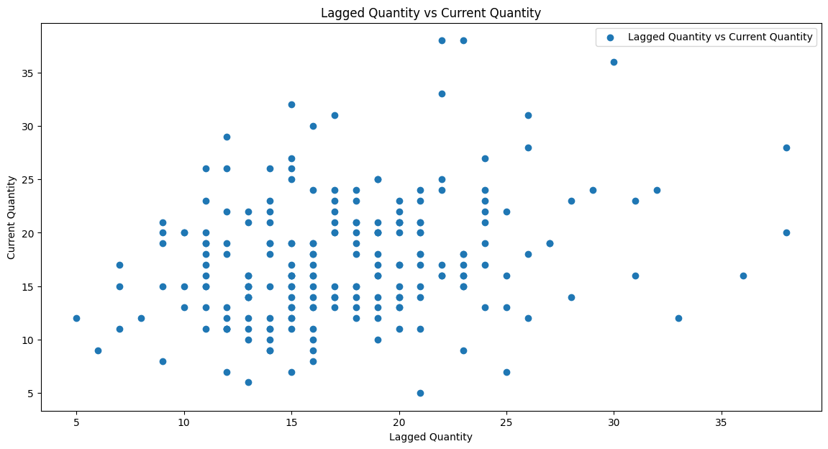
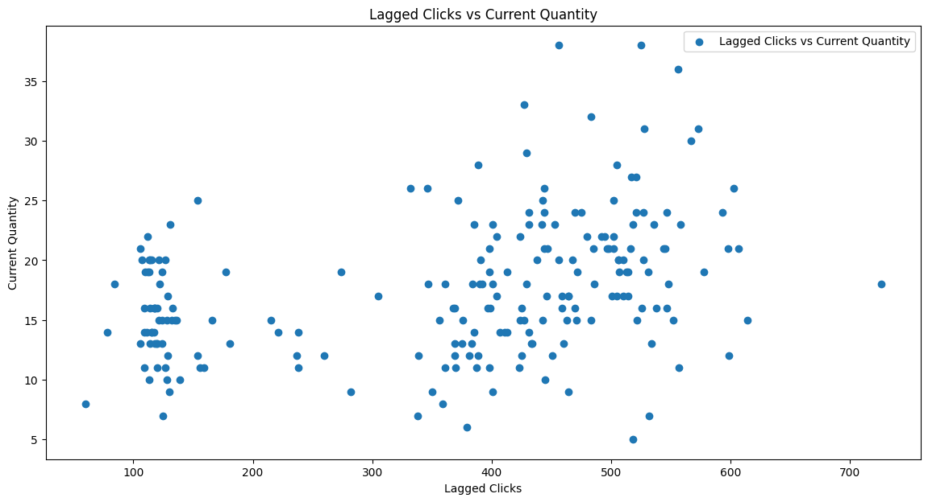
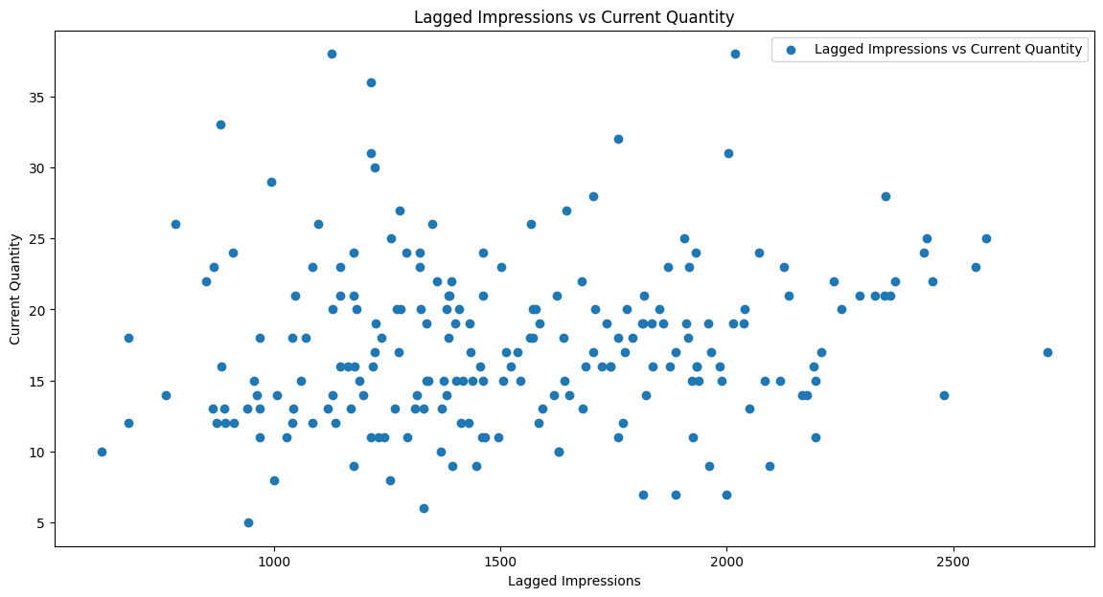
Lagged Effects:
-> Positive Correlation: There is a positive correlation between lagged quantity and current quantity, as higher lagged quantities tend to be associated with higher current quantities.
-> Data Spread: The data points are spread across a range of lagged quantities from about 5 to 35 and current quantities from about 5 to 35, with a notable cluster around lagged quantities of 10 to 20 and current quantities of 10 to 25.
-> Weak Correlation: There is no clear correlation between lagged clicks and current quantity, as the data points are widely scattered.
-> Clustered Data: There are two notable clusters of data points around lagged clicks of 100-200 and 400-500, with quantities mostly between 10 and 20.
-> The scatter plot shows no clear correlation between lagged impressions and current quantity, with data points widely scattered, indicating lagged impressions do not strongly predict current quantity.
-> Data points are dispersed across a wide range, with moderate clustering in lower ranges of lagged impressions (below 1500) and current quantity (below 20), along with some outliers.

Slide 13
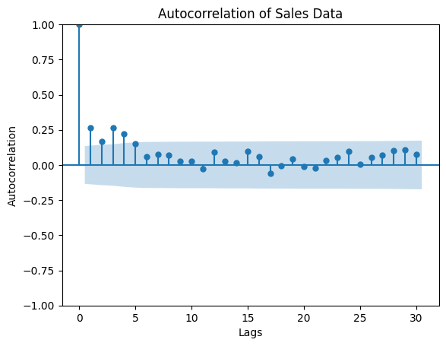
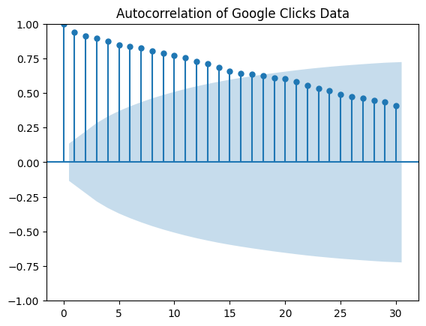
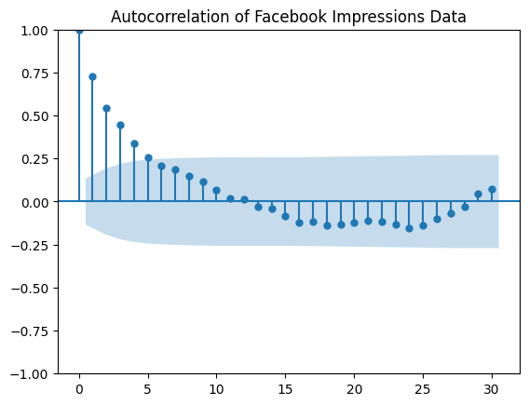
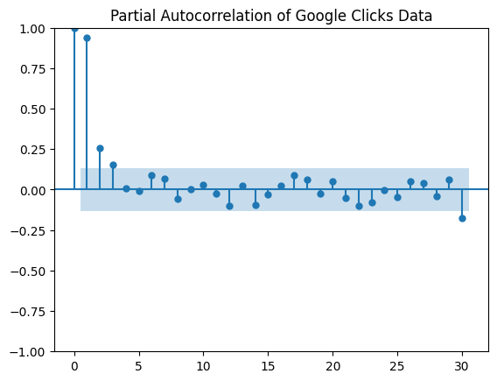
Autocorrelation:
ACF Plot:
- Significant at lag 1, quickly becomes insignificant.
PACF Plot:
- Significant at lag 1, quickly falls within bounds.
ACF Plot:
- Strong, slowly decaying autocorrelation.
PACF Plot:
- Significant spike at lag 1, smaller subsequent spikes.
ACF Plot:
- Significant positive autocorrelation up to lag 10, then mostly negative.
PACF Plot:
- Significant at lags 1, 2, and 3; primarily explained by the first few lags.

Slide 14
Demand Forecast Models:
Model Training and Evolution:
The data is split into Tested Data, Trained Data, Validation Data
Metrics Used:
-> RMSE: Root Mean Square Error
-> MAE: Mean Absolute Error
-> MAPE: Mean Absolute Percentage Error
Model Parameters:
The values for p, d, and q were identified using the ACF and PACF plots:
-> p = 1
-> d = 0
-> q = 1

Slide 15
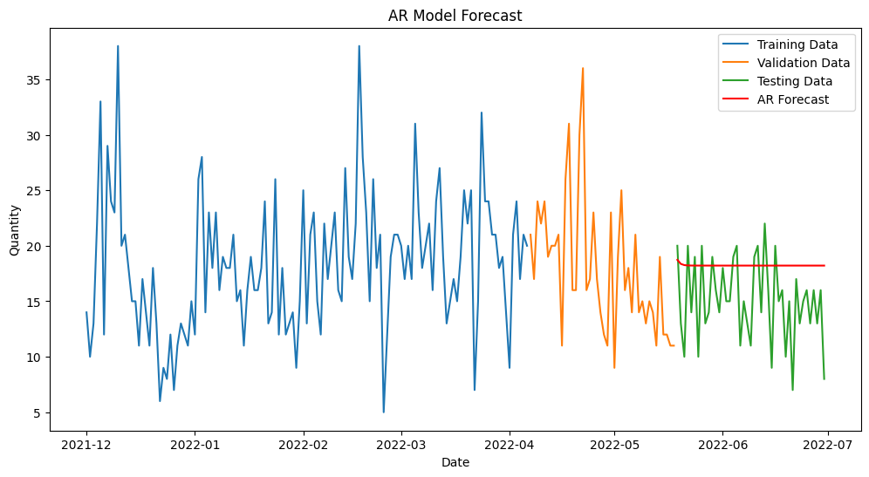

AR Model
MA Model
Test Data:
RMSE: 4.79
MAE: 3.93
MAPE: 33.37%
Validation Data:
RMSE: 5.95
MAE: 4.78
MAPE: 29.26%
Test Data:
RMSE: 4.79
MAE: 3.94
MAPE: 33.39%
Validation Data:
RMSE: 5.95
MAE: 4.79
MAPE: 29.30%
The model's errors are larger for the validation set compared to the test set, as indicated by higher RMSE and MAE values for validation, while the relative error (MAPE) is higher for the test data, suggesting potential issues with model consistency or overfitting.
The MA model exhibits larger errors on the validation set compared to the test set (higher RMSE and MAE for validation), but has a higher relative error on the test data (higher MAPE), indicating potential issues with model consistency or overfitting.

Slide 16
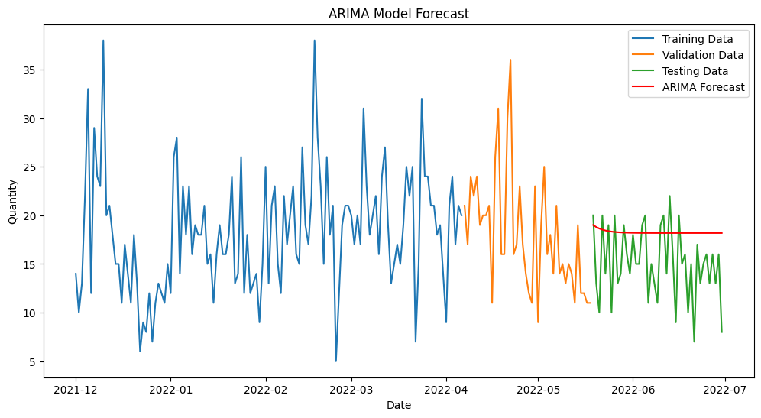
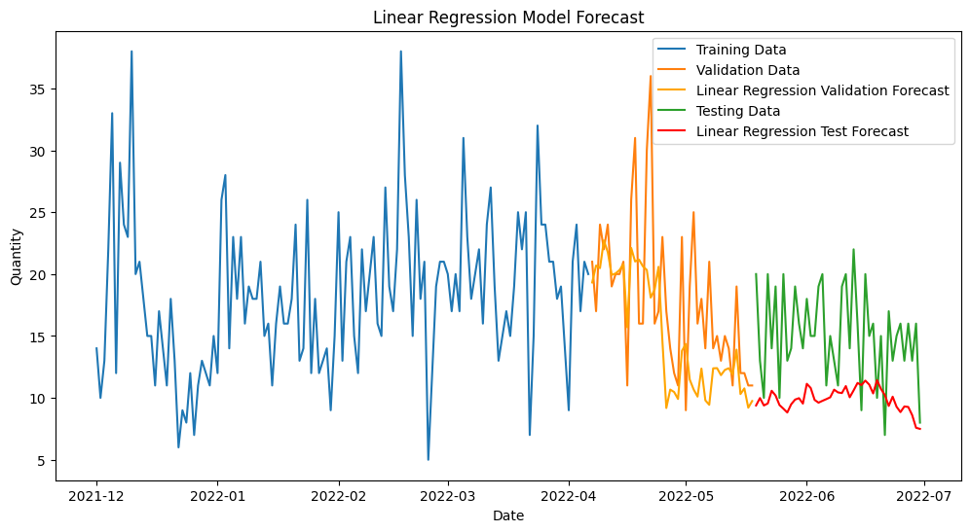
ARIMA Model
Multivariant Linear Regression
Test Data:
RMSE: 4.81
MAE: 3.93
MAPE: 33.44%
Validation Data:
RMSE: 5.92
MAE: 4.75
MAPE: 29.09%
Test Data:
RMSE: 6.31
MAE: 5.48
MAPE: 33.60%
Validation Data:
RMSE: 5.88
MAE: 4.36
MAPE: 23.08%
The ARIMA model shows larger errors on the validation set compared to the test set, with higher RMSE and MAE values for validation, but a higher relative error on the test data (higher MAPE), indicating potential issues with model consistency or overfitting.
The Linear Regression model performs better on the validation data compared to the test data, as evidenced by lower RMSE, MAE, and MAPE values for validation. This indicates that the model's predictions are more accurate on the validation set but shows higher errors on the test data, suggesting potential issues with generalization or overfitting.

Slide 17
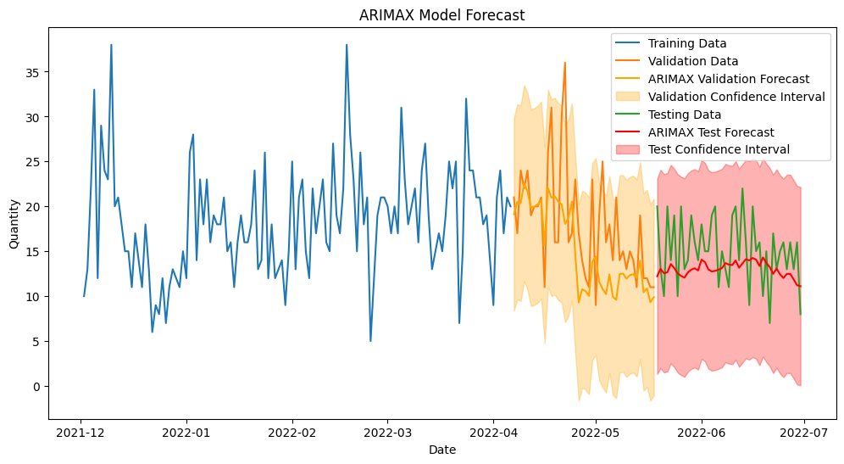
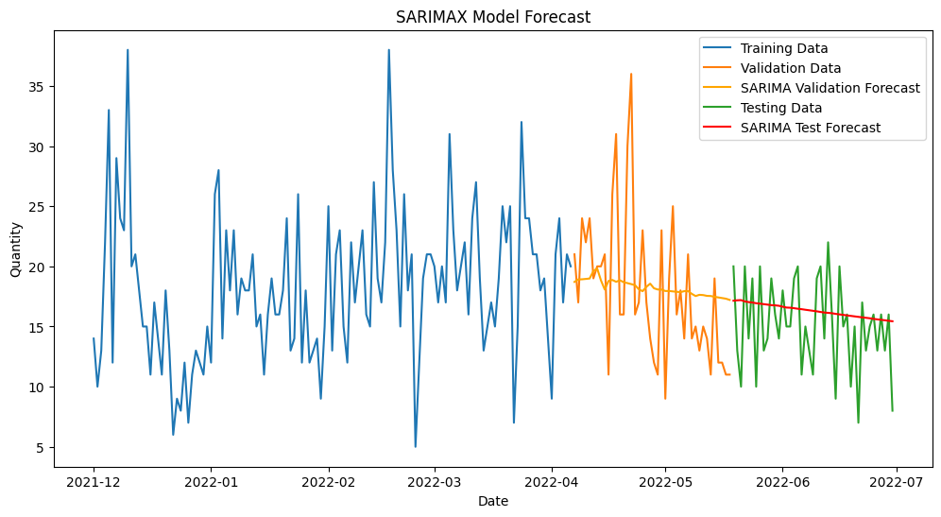
ARIMAX Model
SARIMAX Model
Test Data:
RMSE: 4.18
MAE: 3.42
MAPE: 22.79%
Validation Data:
RMSE: 5.85
MAE: 4.32
MAPE: 22.74%
Test Data:
RMSE: 3.76
MAE: 3.06
MAPE: 24.94%
Validation Data:
RMSE: 5.70
MAE: 4.55
MAPE: 27.70%
The ARIMAX model performs better on the test data compared to the validation data, showing lower RMSE and MAE, indicating more accurate predictions. The MAPE is slightly higher on the test data, suggesting marginally higher relative error. Overall, the model is effective but exhibits minor variability in performance across different datasets.
The SARIMAX model performs better on the test data than on the validation data, with lower RMSE, MAE, and MAPE values on the test data. This indicates more accurate predictions on the test set and suggests that the model generalizes well.

Slide 18
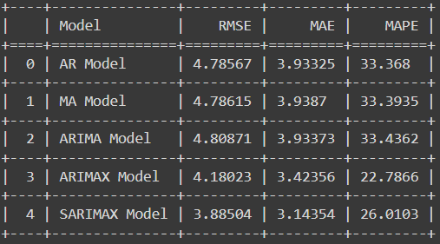
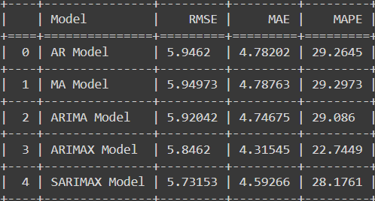
Comparision Of Model:
Test Data Metrics
Validation Data Metrics

Slide 19
CONCLUSION:
The ARIMAX model is preferred for forecasting due to its lowest RMSE of 4.18023 and MAE of 3.42356, indicating superior accuracy.
In comparison, the SARIMA model shows a higher RMSE of 4.80871.
ARIMAX excels in capturing relationships with exogenous variables, making it the favored choice.
Overall, ARIMAX is selected for its accuracy and capability to incorporate additional predictors effectively.

